Slide 1
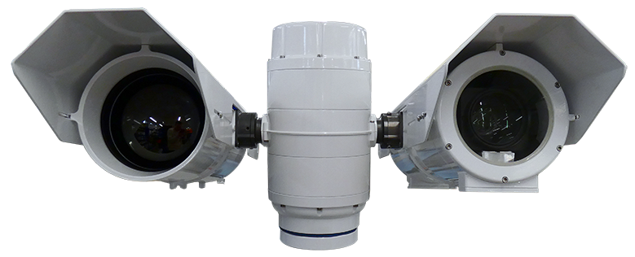
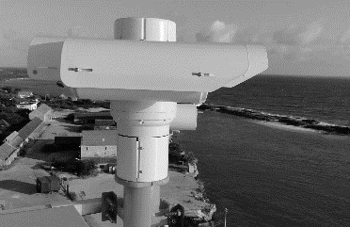
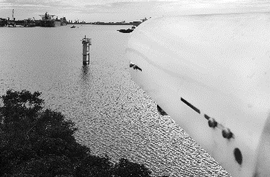
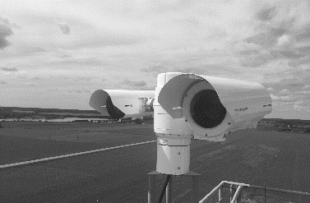
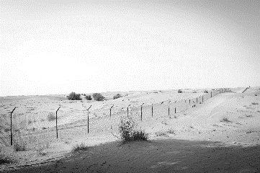
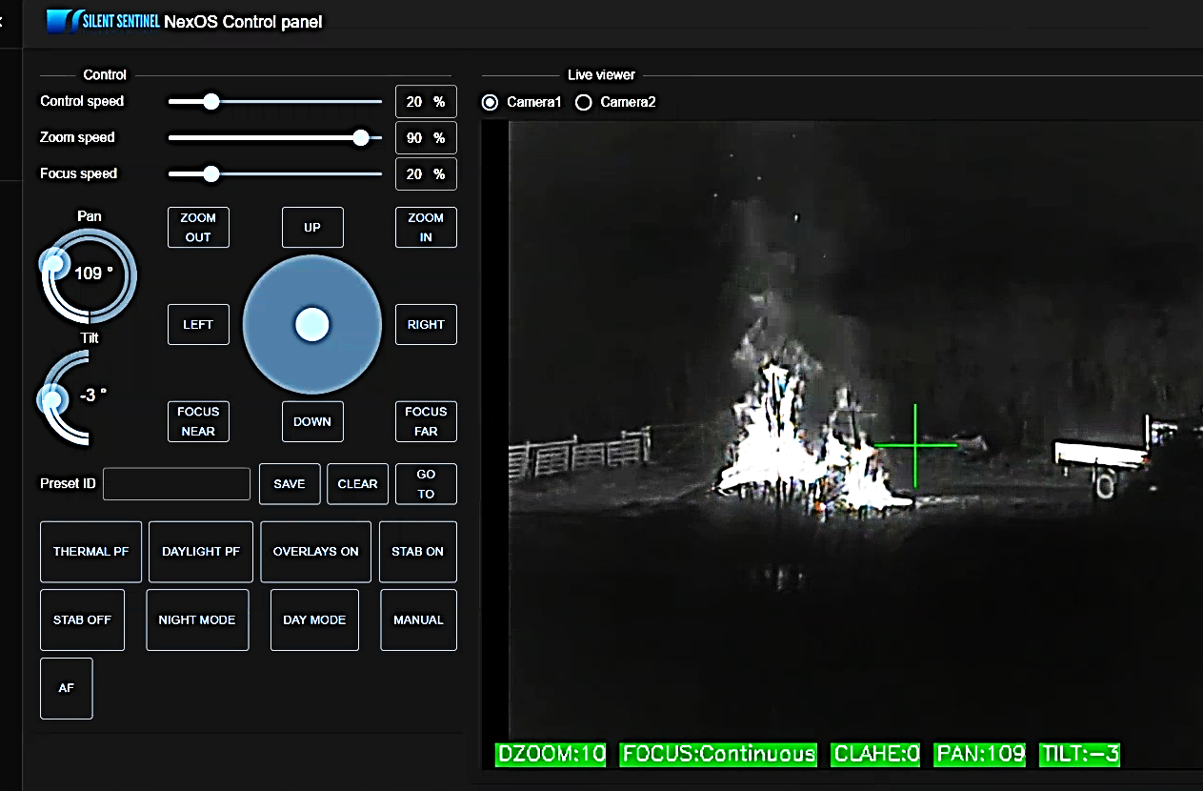
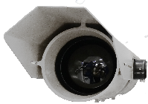
OSIRIS RANGER
Powered by
TECHNICAL SPECIFICATION
THERMAL SENSORS | OPTX-EVO2-100-W | OPTX-EVO2-105-W | OPTX-EVO2-150-W | OPTX-EVO2-180-W | OPTX-EVO2-225-W
Focal Length | 20mm to 100mm | 26mm to 105mm | 30mm to 150mm | 30mm to 180mm | 25mm to 225mm
Horizontal FOV | 22° (W) to 4.4° (T) | 16.9° (W) to 4.2° (T) | 14.7 (W) to 2.9° (T) | 14.7° (W) to 2.4° (T) | 17.6° (W) to 2.0° (T)
F Number | F1.1 | F1.6 | F1.2 | F1.2 | F1.5
Optical Zoom (Continuous) | 5x, Motorised | 4x, Motorised | 5x, Motorised | 6x, Motorised | 9x, Motorised
Digital Zoom | 20x
Focus | Push autofocus, continuous autofocus, continuous autofocus with automatic ROI, manual
Detector Type | Uncooled VOx microbolometer, ≤50mK (at 25℃, F1.0), 50Hz, 12μm, 640 x 512
Spectral Band | 7.5 to 14μm (LWIR / 8 to 14μm)
Image Processing | Correction (NUC), noise filtering, polarity control, Digital Detail Enhancement (DDE), polarity: white hot / black hot, 18x colour palettes
Housing Weight (Typical) | 12Kg / 26.4lb | 26mm to 105mm | 30mm to 150mm | 30mm to 180mm | 25mm to 225mm
Housing Size (Typical) | L572 x W258 x H226mm | 26mm to 105mm | 30mm to 150mm | 30mm to 180mm | 25mm to 225mm
HIGH PERFORMANCE PAN AND TILT UNIT
HD LOW LIGHT VISIBLE ZOOM LENS SENSORS
SD LWIR UNCOOLED THERMAL ZOOM LENS SENSORS
The OSIRIS RANGER EVO2 is an accurate, multi sensor platform which utilises long range uncooled LWIR thermal sensors with a range of zoom lens options up to 25-225mm, alongside the latest low light HD visible sensors with zoom lens options up to 20-2400mm. The EVO2 range employs the latest 12μm thermal sensor technology and has intelligent capabilities as standard.
Combining advanced motor control technology along with harmonic drive gears, all Osiris camera platforms are able to position our long-range sensors accurately and quickly. This is complimented with advanced features* such as video tracking, target classification and dynamic bore-sighting.
HD VISIBLE SENSORS
Focal Length | 4.3mm to 129mm | 15.2mm to 500mm
Horizontal FOV | 63.7° (W) to 2.32° (T) | 23.42° (W) to 0.78° (T)
F Number | F1.6 to F4.7 | F3.0 to F32
Optical Zoom (Continuous) | 30x, Motorised | 33x, Motorised
Digital Zoom | 20x
Focus | Push autofocus, continuous autofocus, continuous autofocus with automatic ROI, manual
Image Sensor | 1/2.8“ CMOS Exmor (2.13MP), full HD 1080p (1920 x 1080) | 1/1.9” CMOS Sensor (2.38 MP), full HD 1080p (1920 x 1080)
Min. Sensitivity | Colour 0.01 lux Mono 0.0008 lux (high sensitivity mode) | Colour 0.05 lux F1.2 gain of up to 60dB / 0.005 lux F1.2 / AGC @ 42dB Mono 0.002 lux F1.2 gain of up to 60dB / 0.0002 lux F1.2 / AGC @ 42dB (accumulation 25 times)
Image Processing | Digital noise reduction
Housing Weight (Typical) | 14Kg / 30.9lb | 17Kg / 37.4lb
Housing Size (Typical) | L572 x W258 x H231mm | L800 x W258 x H231mm
KEY FEATURES
Thermal camera detection ranges up to 6.98km (human) **
640x512 12μm thermal sensors with zoom lens options up to 225mm
HD visible sensors with zoom lens options up to 2400mm
intelligence allows advanced image processing and motor control
Procedure Manager and Pelco Query Builder allow advanced configurations
Push, continuous and ROI autofocus, electronic image stabilisation and digital zoom (20x) as standard
360° Continuous rotation with pan and tilt speeds between 0.001° and 100° per second
High level of camera positioning accuracy: 0.0001° / 0.0017 mRad
Unique cable managed, rapid release mechanism and bore sighting allows a quick installation in the field
System configuration and sensors can be chosen to suit the specific requirements
Ideally suited for single mast deployments such as mobile, border and maritime applications
NexOS*
NexOS Core (Standard) | NexOS Core includes: Push autofocus, continuous autofocus, continuous autofocus with automatic ROI, digital zoom, image contrast enhancements, de-fog, electronic image stabilisation (2D), static overlays, remote upgrades, remote diagnostics
NexOS Performance Pack (Cost Option) | In addition to NexOS Core, includes: Electronic image stabilisation (3D), target tracking, target classification, event detection, dynamic overlays, dynamic boresight, dynamic absolute positioning, edge recording
OSIRIS PAN AND TILT UNIT (PTU)*
Pan Range / Velocity | 360° Continuous; 0.001° - 100° per second**
Tilt Range / Velocity | -90° to +90°; 0.001° - 100° per second**
Accuracy | 0.0001° / 0.0017 mRad
Repeatability | 0.0001° / 0.0017 mRad
Actuation | Custom stepper motors
Speed Control | Zoom dependent speed control (subject to payload)
Presets Types | Procedural, Positional
Number of Presets | 255
Protocols | Pelco D, ONVIF Profile-S (custom available on request)
Interface | RS485, ONVIF Profile-S, Serial <> IP
Positioning | Absolute positioning feedback
Through Shaft | No
PTU Weight (Typical) | 18kg / 39.7lb (excluding mounts and payloads, payload capacity 50kg)
PTU Size (Typical) | H450 x W225x D225mm (excluding mounts and payloads)
ELECTRICAL AND MECHANICAL
Video Output | RTSP, ONVIF from PTU (H.264, H.265 and MJPEG)
Ethernet | Command and control of all functions including streaming of H.264, H.265 and MJPEG video
RS485 | Pelco D command and control with custom procedural extensions
Rapid Release Mechanism | Yes
Input Voltage | 48VDC
Housing Material | Anodised aluminum, white powder marine grade paint finish (other colours are available upon request)
IP Rating | IP67
Temperature Range | -30°C (-22°F) up to 65°C (149°F) (-40°C with optional heaters)
Above: Typical Osiris Ranger (models will vary)
* Requires the NexOS performance pack option.
** Johnsons Criteria, (Human at 1.8m x 0.5m, Detection at 2 pixels, Recognition at 8 pixels and Identification at 13 pixels. 50% probability subject to environmental conditions). Based on the JPTX-EVO2-300-W.
OPTIONALLY AVAILABLE
HD Low Light Visible Sensor | 16.7mm to 2000mm (21.2° W to 0.23° T) (with x2 extender on) 1/1.9” CMOS Sensor (2.38MP), full HD (1920 x 1080), colour 0.005 lux at F1.2 / 42dB mono 0.0002 lux at F1.2 / 42dB
HD Ultra Low Light Visible Sensor | 15.2mm to 500mm (32.39° W to 1.0° T) or 20mm to 2400mm (24.87° W to 0.23° T) (with x2 extender on) 2/3” CMOS Sensor (2.2MP), full HD (1920 x 1080), colour 0.005 lux at F1. 4 / 50IRE, mono 0.000000001 lux at F1.4 / 50IRE
4K Visible Sensor | 4.4mm to 88.4mm (70.2° W to 4.1° T) 1/2.5” CMOS Sensor (8.51MP), 4K/QFHD (3840 x 2160), colour 0.4 lux (colour 0.06 lux with slow shutter on)
Technologies | Long range white light (up to 3.5km) or infra-red illuminators (up to 2.5km), laser illuminators, SWIR sensors, wiper for visible cameras
* Subject to payload types.
** Maximum pan and tilts speeds may be restricted depending on the payload types.
IP67
Ruggedised and well suited to maritime applications
HIGH ACCURACY
Designed for long range
surveillance applications
MODULAR DESIGN
Enables cost effective, accurate long range surveillance
RAPID RELEASE MECHANISM
Allows quick changing
of payloads
NEXT GENERATION
Unrivalled intelligence and hardware control from NexOS
SILENTSENTINEL.COM
PLEASE CONTACT US FOR A SPECIFIC CONFIGURATION
Specifications may be subject to change without notice 19/02/23 V4.0
REACH
RoHS
UK Manufacturer

